Slide 1
PetBook
Capstone Project

Slide 2
PURPOSE The booming digital age means more pet owners are using smart devices to stay more connected to their pets. This project looks at providing a solution to more traditional forms of data storage to help improve pet care, communication, efficiency, personalization, and convenience..
Affordability: pet products and services can be expensive and inaccessible to many pet owners, particularly those with lower incomes.
Space: less physical space wastage if information is stored on a server or database
WHY THE PROBLEM IS VALUABLE TO ADDRESS?
Durability and Sustainability: digital storage can be stored and backed up in multiple locations and is more environmentally friendly than paper storage.
Searchability: data much more easily searched as well as faster.
Accessibility: digital information can be accessed anywhere
Notes:
A recent study examining pet ownership in NZ done by Eastern Institue of Tech, Hawkes Bay and School of Vet Science, Uni of Queensland have shown companion animal pet ownership in NZ has been estimated to be 64% of households, according to Companion Animals New Zealand (CANZ, 2020). This ranks NZ 2nd following the US
As a pet-owner nowadays, your schedule is probably jam-packed. Between managing your schedule etc you might feel like you’re being hounded with new tasks every day.
Something is needed to give owners a peace of mind, and help reduce stress and anxiety. This can be especially helpful for new pet owners (who are still getting used to their pet's routine)
Space
Searchability – digital information is index so makes it easier and faster to earch for specific information
Accessibility
Affordability - More affordable pet products and services to ensure that all pets receive the care they need.
Durable and sustainable

Slide 3
Current State of the digital Pet Service Industry
In the broader pet care industry, digital pet data storage and management is a niche market but expected to grow.
Notes:
There is a boom in health and wellness with shifts into trends of digitalization, higher quality food, pampering, vitamins and insurance but there is a need for more accessibility to apps that focusing on helping owners store their pets information

Slide 4
Desired state for the industry
To create a platform that provides services to pet owners to organise and manage their pet's health etc stress-free. Users control their data and can decide on how it's used and shared.
Notes:
Easier management
Less stress
Healthier and happier animals and owners

Slide 5
Yes, the projects have proved quite popular with users but are not well known especially in NZ
Has this problem been addressed by other projects? What were the outcomes?
Notes:
Pet service convivences are extremely popular; ones with similar functionality, both free and subscription, are available but are not very well known.

Slide 6
INDUSTRY/DOMAIN Pet services industry

Slide 7
PET SERVICE INDUSTRY VALUE-CHAIN
The pet service industry makes money in various ways from getting consumers to register for a pet service platform to ads on their apps or websites, to paid premium services and subscriptions.
KEY CONCEPTS IN THE INDUSTRY
pet health and wellness
Humanization, premiumization, health and wellness, sustainability, and digitalization.
Attract as many users or subscriptions as possible
Use of related and relevant ads to generate revenue if use free
Staying ahead of trends to prevent losing marketvalue/share
Notes:
Value-chain:
The pet service industry is currently thriving, with the demand for pet services and products increasing steadily in recent years. This has resulted in a surge in demand for pet-related services, such as veterinary care, grooming, boarding, pet sitting, and dog walking. However, the pet service industry is not without its challenges. One of the biggest challenges is building a brand and reputation in a crowded and competitive market. Many startups also struggle with funding and scaling their operations, particularly when it comes to expanding into new markets or regions.
Key Concepts:
Humanization, premiumization, health, wellness, sustainability and digitalization are the five key trends shaping global pet care and these are set to drive demand in the future.
Many services focus on:
Get as many users or subscritions as possible
Use of related and relevant ads to generate revenue if use free
3. staying ahead of trends to prevent losing marketshare

Slide 8
RELEVANCE IN OTHER INDUSTRIES....
Healthcare, Finance, Retail, and Education
Notes:
many of the features and benefits of a digital pet information storage app, such as easy access to information, improved accuracy, and enhanced security CAN/MAY be applied to other industries where information management is crucial

Slide 9
Stakeholders Anyone who owns a pet
WHY DO THEY CARE?
Digitalizing pet information can help users provide better care for their pets.
WHAT ARE THEIR EXPECTATIONS?
They expect PetBook to be easy to use, useful and accessible.
Notes:
By using an app to stay organized, pet owners can feel more confident and less stressed, which can benefit both the pet and the owner. Increased security, convenience and sustainability are other benefits.

Slide 10
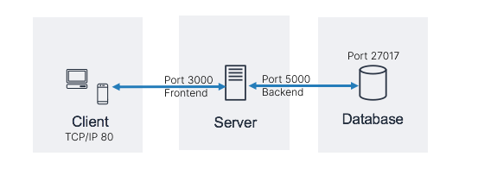
Architecture design

Slide 11
USER STORIES
# | User Story Title | User Story Description | Priority | Additional Notes
1 | Availability | As an end user, I want the same content and services to be accessible across multiple devices | 2
2 | Interface | As an end user, I want the interface to be intuitive and responsive as well as have a similar feel across multiple devices | 2
… | Content | As an end user, I want the ability to be able to upload, update records and pet information as needed | 1
 | Housekeeping | As and end user, I want to be able to edit information to keep everything updated or delete information that I no longer require | 2
 | Locating Content | As an end user, I want an easy and reliable way to access relevant content | 1
 | Managing content | As end user, I want an easy way to manage, schedule and organize my pet (information) to ensure the best quality of life for them | 1
Notes:
Since the main purpose of this project is to digitalise information; accessibility, housekeeping and content management were top priority followed by a user friendly interface

Slide 12
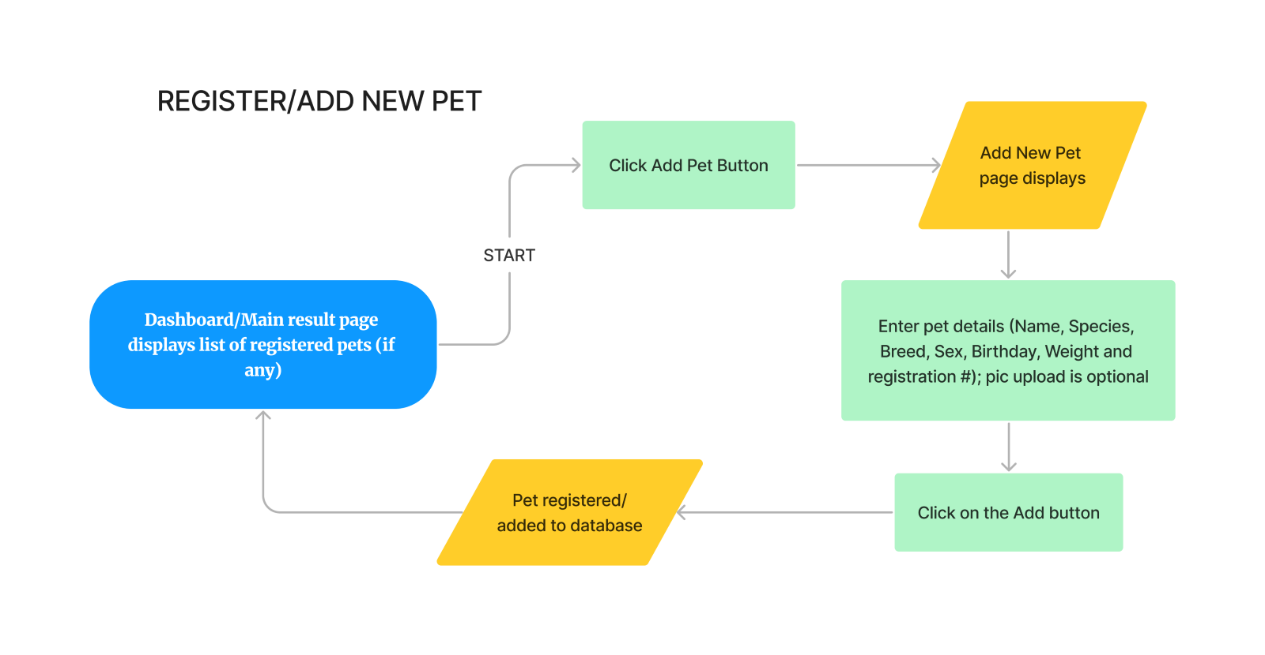
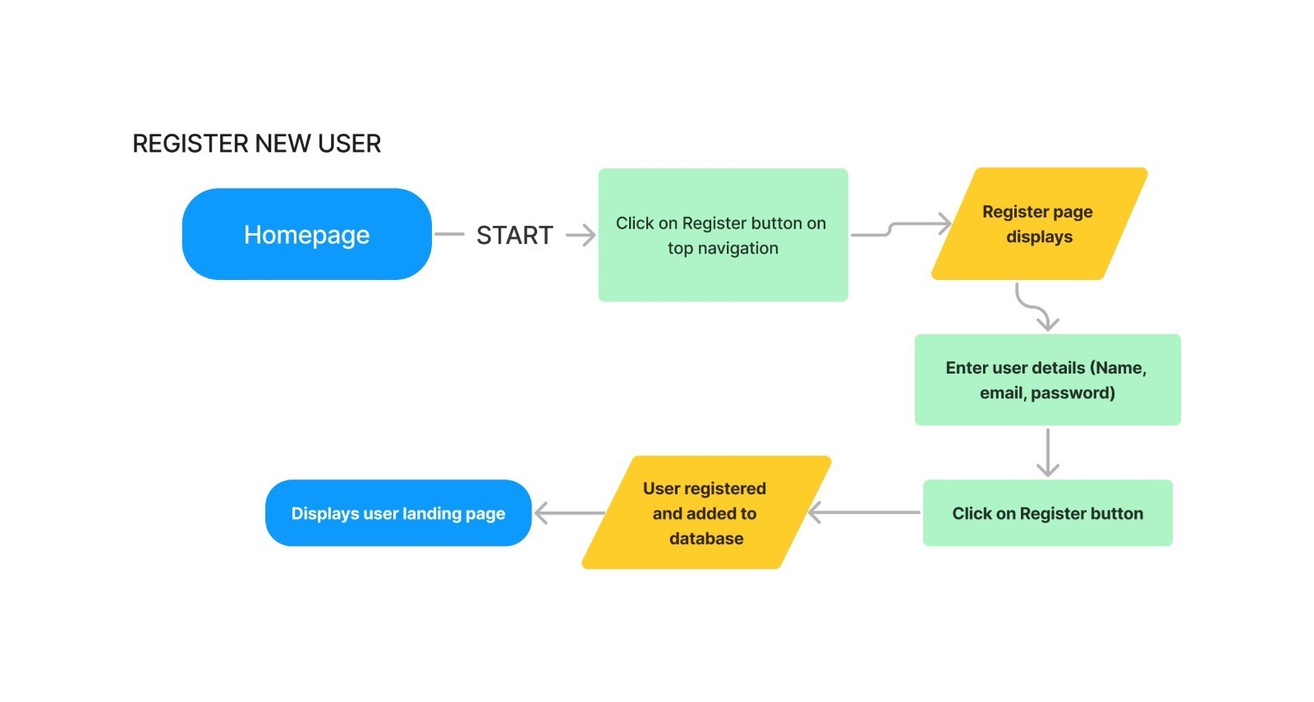
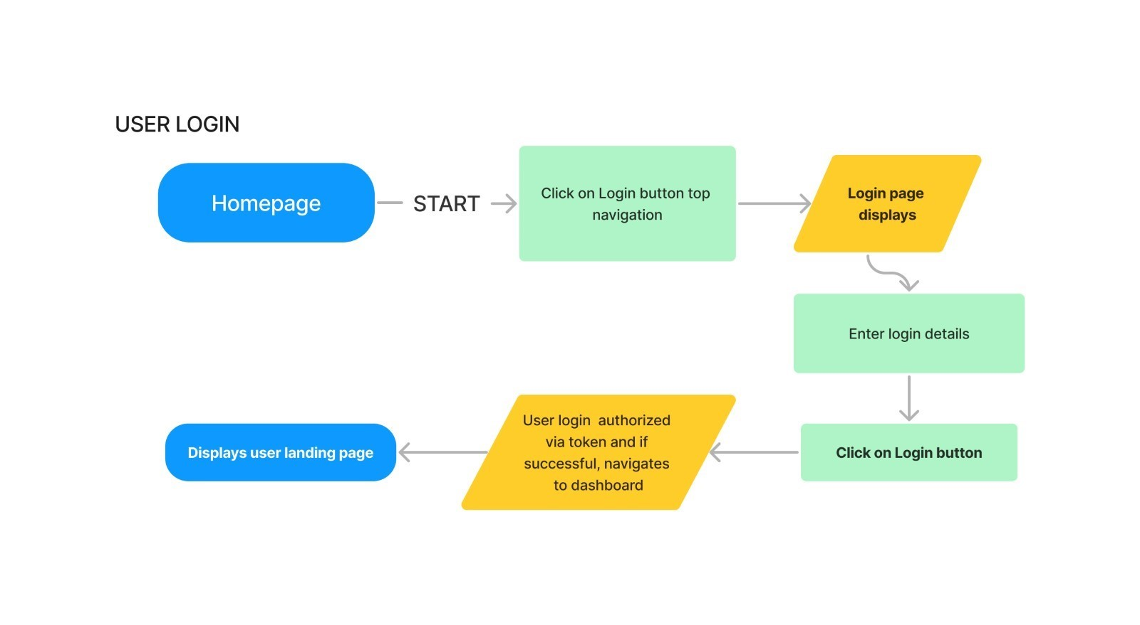
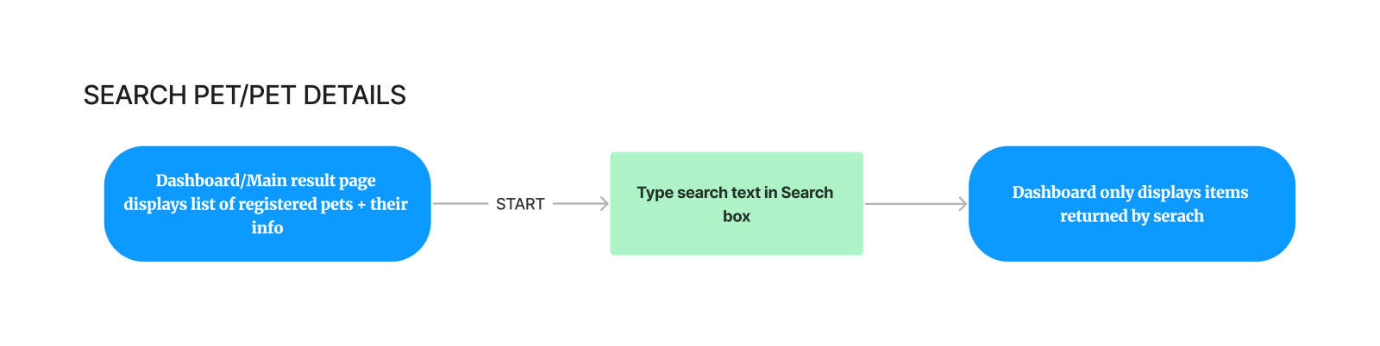
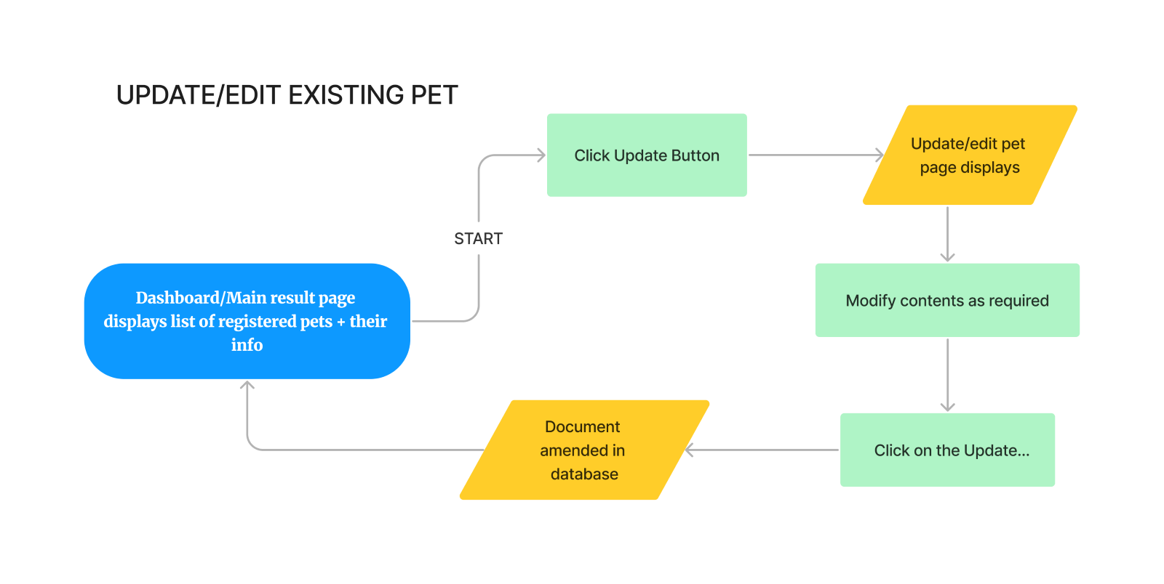
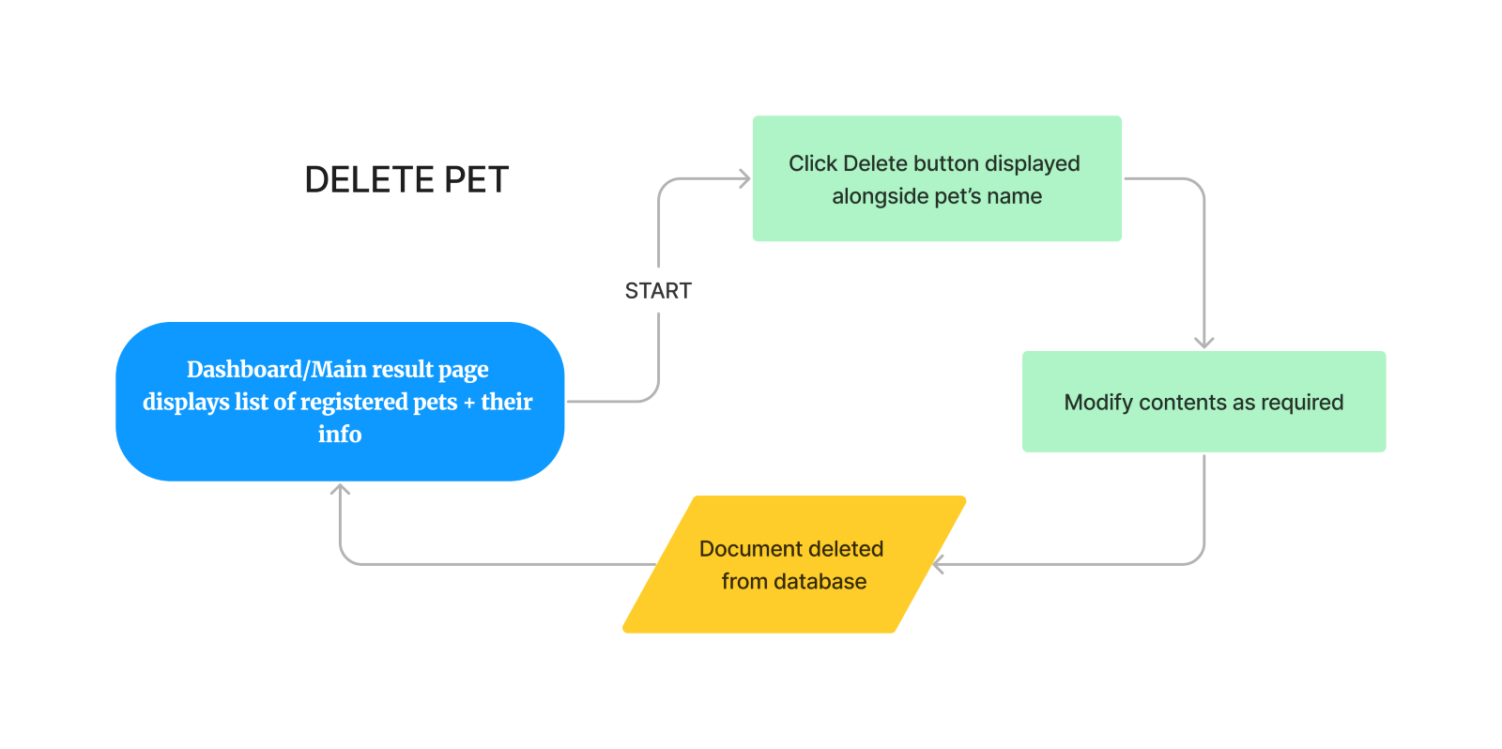
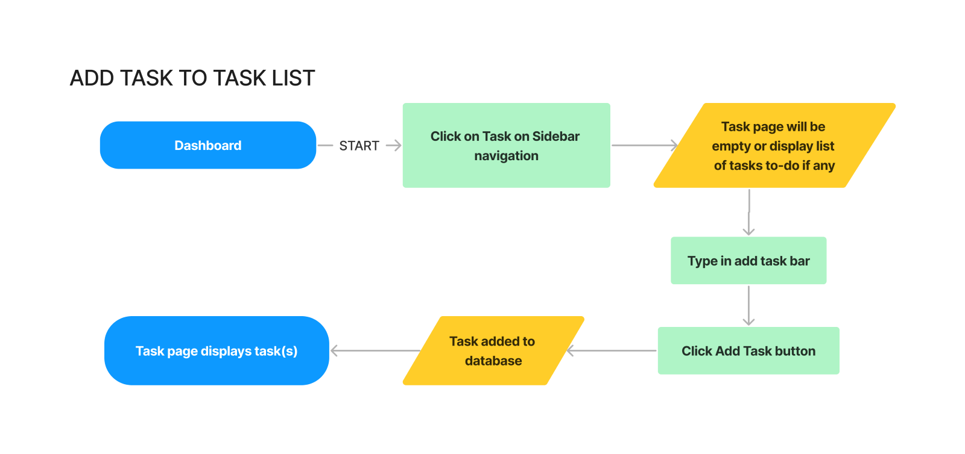
User flow

Slide 13
FIGMA DESIGNS
Notes:
Show figma designs

Slide 14
In scope
Register new user
Edit user details
Retrieving all items
Search by pet details/record details
Register new pets
Update existing pets
Add pet health records
Update pet records
Delete records
Private content
Automatic database creation
OUT OF SCOPE
The following are considered out of scope:
Encryption/HTTPS
Multiple file uploads. Currently only able to upload single files of specified type (images)
User customization currently limited
Automated reminders and user notifications (could be in scope if I had more time)
‘Forgotten password’ retrieval service
Inclusion of a vet and pet care knowledge database
Compressed files/folder options for records

Slide 15
Non-functional Requirements
Security
Any personal information added to the database is private and requires proper user-specific authentication and authorization to be accessed.
Passwords are also hashed before being saved so user accounts and data will not be compromised any unauthorized access to the database
Reliability
The application response times may depend on the reliability of the user connection.

Slide 16
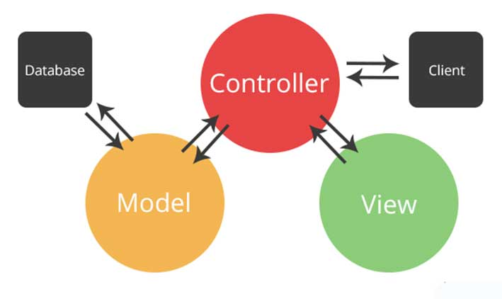
Software Conformity to Technical standards? The backend used the Model view Controller structure and front end has custom hooks that implement shared functionality between components.
This Photo by Unknwn author is licensedunder CC BY.

Slide 17
PROJECT PLANNIING
I used Trello to track tasks and key milestones to completing this project:
Trello Board

Slide 18
Testing strategy
Quality achieved by ensuring continual testing, development and documentation.
Multiple tests were carried out where bugs were recorded. These then went back to the development stage to be fixed
Utilising console.log
Made sure the application looked like Figma design throughout the process
Postman was used to test during API creation.
test scripts were run to check client-side functionality
Notes:
3. CONSOLE.LOG - I utilized console.log() at every step of the failing process to check for any abnormalities in my code. By logging values of variables or data at different points, I was able to get a better understanding of how my code was executing and identify errors or unexpected behavior
5. used excel to record tests and bugs (show excel sheet)

Slide 19
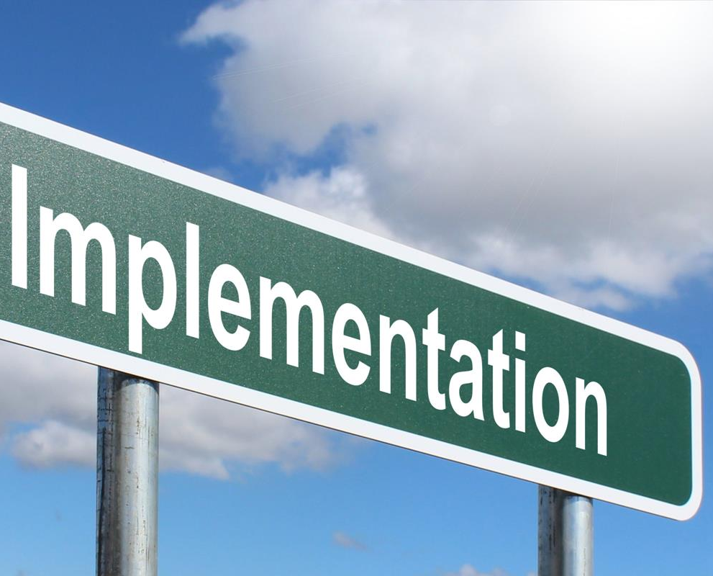
Considerations for deploying PetBook was to use AWS EC2 or Elastic Beanstalk with docker compose running 2 docker containers.
To allow 24x7 access for any device, the software is to be deployed to AWS EC2 free tier. A user installing the same software has the option to choose their own hosting provider.
To not incur costs and allow users to not share their links, each user needs to set up their own database. Database configuration needs to be added post install.
This Photo by Unknown author is licensed under CC BY-SA.

Slide 20
End to end solution
Went well.
PetBook registers users and securely stores owner/pet information.

Slide 21
PETBOOK CODE
Code and documentation relating to this project is available from the following GitHub repository:
https://github.com/unishu/Capstone-Project-PetBook

Slide 22
References
React
Expressjs
Mongo Compass
Docker
Nodemon
node
cors
body-parser
Cloudinary
Pexels
Database is hosted by https://www.mongodb.com/atlas/database

Slide 23
DEMO

Slide 24
Questions?

